Slide 1

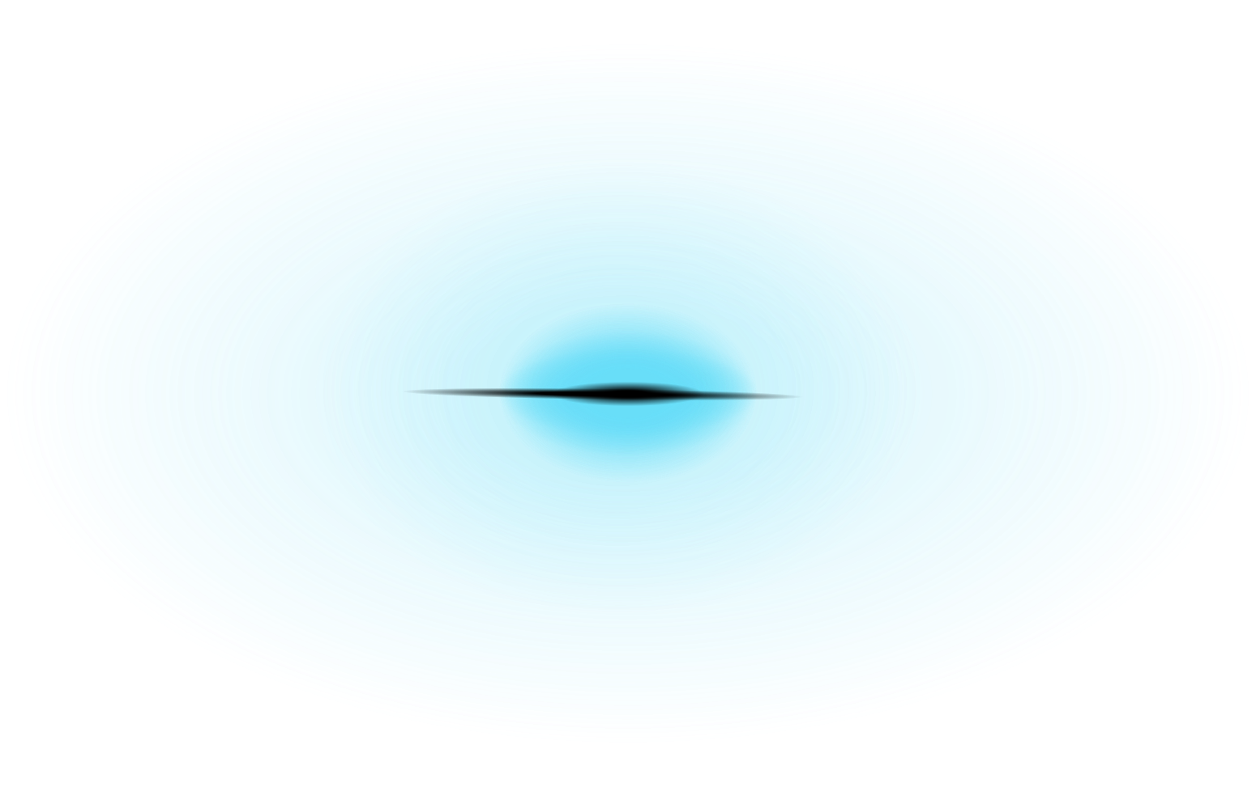


Car Crusher

Slide 2
Team Members
▪︎ Adnan Hatim
▪︎Murtaza Hunaid
▪︎ Turab Ali Zaidi
▪︎ Mohammad Aizaz

Slide 3
Game Concept
Car Crasher is a high-speed, driving game where players take control of a car and navigate through a chaotic city environment. The primary objective is to avoid collisions with enemy cars while maximizing your score.

Slide 4
Core Mechanics
Player Control: Players will use keyboard inputs to steer their car.
Enemy Cars: enemy cars will constantly spawn and move towards the player's car.
Collision Detection: The game will accurately detect collisions between the player's car and enemy cars.
Scoring System: Players will earn points by surviving, the longer he survives the greater the points he gets
Game Over: Player will lose upon colliding with an enemy car.

Slide 5
Technical Details
<stdio.h>: This library is used for input and output operations. Functions like printf and scanf are defined in this library, allowing the program to display messages to the console and read user input.
<time.h>: This library provides functions to manipulate and measure time. In this game, it is used to calculate the elapsed time for the player's survival, which is displayed as the score.
<conio.h>: This library is used for console input/output. It provides functions like getch(), which allows the program to capture user keystrokes without waiting for the Enter key. This is essential for real-time player movement in the game

Slide 6
Technical Details
<string.h>: This library is used for string manipulation functions. It provides functionalities to handle and manipulate strings, such as copying and comparing strings. In this code, it is used for player name handling.
<stdlib.h>: This library includes functions for memory allocation, process control, conversions, and random number generation. In this game, it is used for the rand() function to generate random positions for enemy cars.
<windows.h>: This library is specific to Windows operating systems and provides access to Windows API functions. It is used here for console manipulation, such as changing the font settings and handling multimedia functions.

Slide 7
Technical Details
<mmsystem.h>: This library is used for multimedia functions, specifically for playing sound files. In this game, it is used to handle background music and sound effects, allowing the game to play audio files during gameplay.
<pthread.h>: This library provides support for multi-threading. It allows the game to run music playback in a separate thread, ensuring that the game can continue to run smoothly while music is playing in the background.

Slide 8
Code Structure

Slide 9
Initialization
Player Position: The player's initial position is set with player_Position_X and player_Position_Y variables, which are initialized in the reset_game_state() function. The player starts at coordinates (15, 10).
Enemy Positions: The enemy positions are stored in arrays enemy_Position_X and enemy_Position_Y. The enemy count is initialized to zero. The reset_game_state() function also resets the enemy count and clears any previous enemy positions.
Game State Variables: Other variables such as game (to track if the game is running) and turn (to control the flow of turns) are also initialized at the start of the main() function.

Slide 10
Game Loop
Game State Management: Inside the loop, the game state is reset, and a clock is started to track the time. The loop runs the following sequence:
Clear the screen.
Create new enemies every two turns using the create_enemies() function.
Move existing enemies using the enemy_Movement() function.
Render the game roads and player/enemy positions using roads_create().
Handle player movement based on input using the player_Movement() function.
Calculate and display the player's score using Show_Score().

Slide 11
Enemy Creation and Movement
Creating Enemies: The create_enemies() function generates enemy positions randomly within specified bounds. It ensures that enemies do not spawn in water or out of bounds. The enemies are added to the arrays enemy_Position_X and enemy_Position_Y, and the enemy_Count is updated.
Moving Enemies: The enemy_Movement() function updates the vertical position of all enemies by decrementing their Y-coordinate, effectively moving them upwards on the screen.

Slide 12
Collision Detection
Detecting Collisions: The player_Movement() function checks for collisions between the player and enemies. It compares the player's position against all enemy positions stored in the arrays. If the player's position matches any enemy position, or if they are adjacent, a collision is detected.
Game Over Conditions: If a collision is detected, the game prints a "Game OVER" message, plays the game over music, and sets the game variable to false (0) to exit the loop. Additionally, it checks if the player goes out of bounds and triggers the same game over conditions.

Slide 13
Scoring System
Calculating Score: The score is calculated based on the elapsed time since the start of the game. The Show_Score() function computes the time difference using the clock() function and displays it in seconds.
Storing Scores: The storing_Score() function saves the player's name and score to a file named "score.txt" for future reference. If the file does not exist, it creates one.
Displaying Scores: The Display_Score() function reads from "score.txt" and displays previous scores, allowing players to see their past performances.

Slide 14
Conclusion
In summary, the Car Crasher game is a simple yet engaging console-based game developed in C.

Slide 15
Thank You

